Slide 1
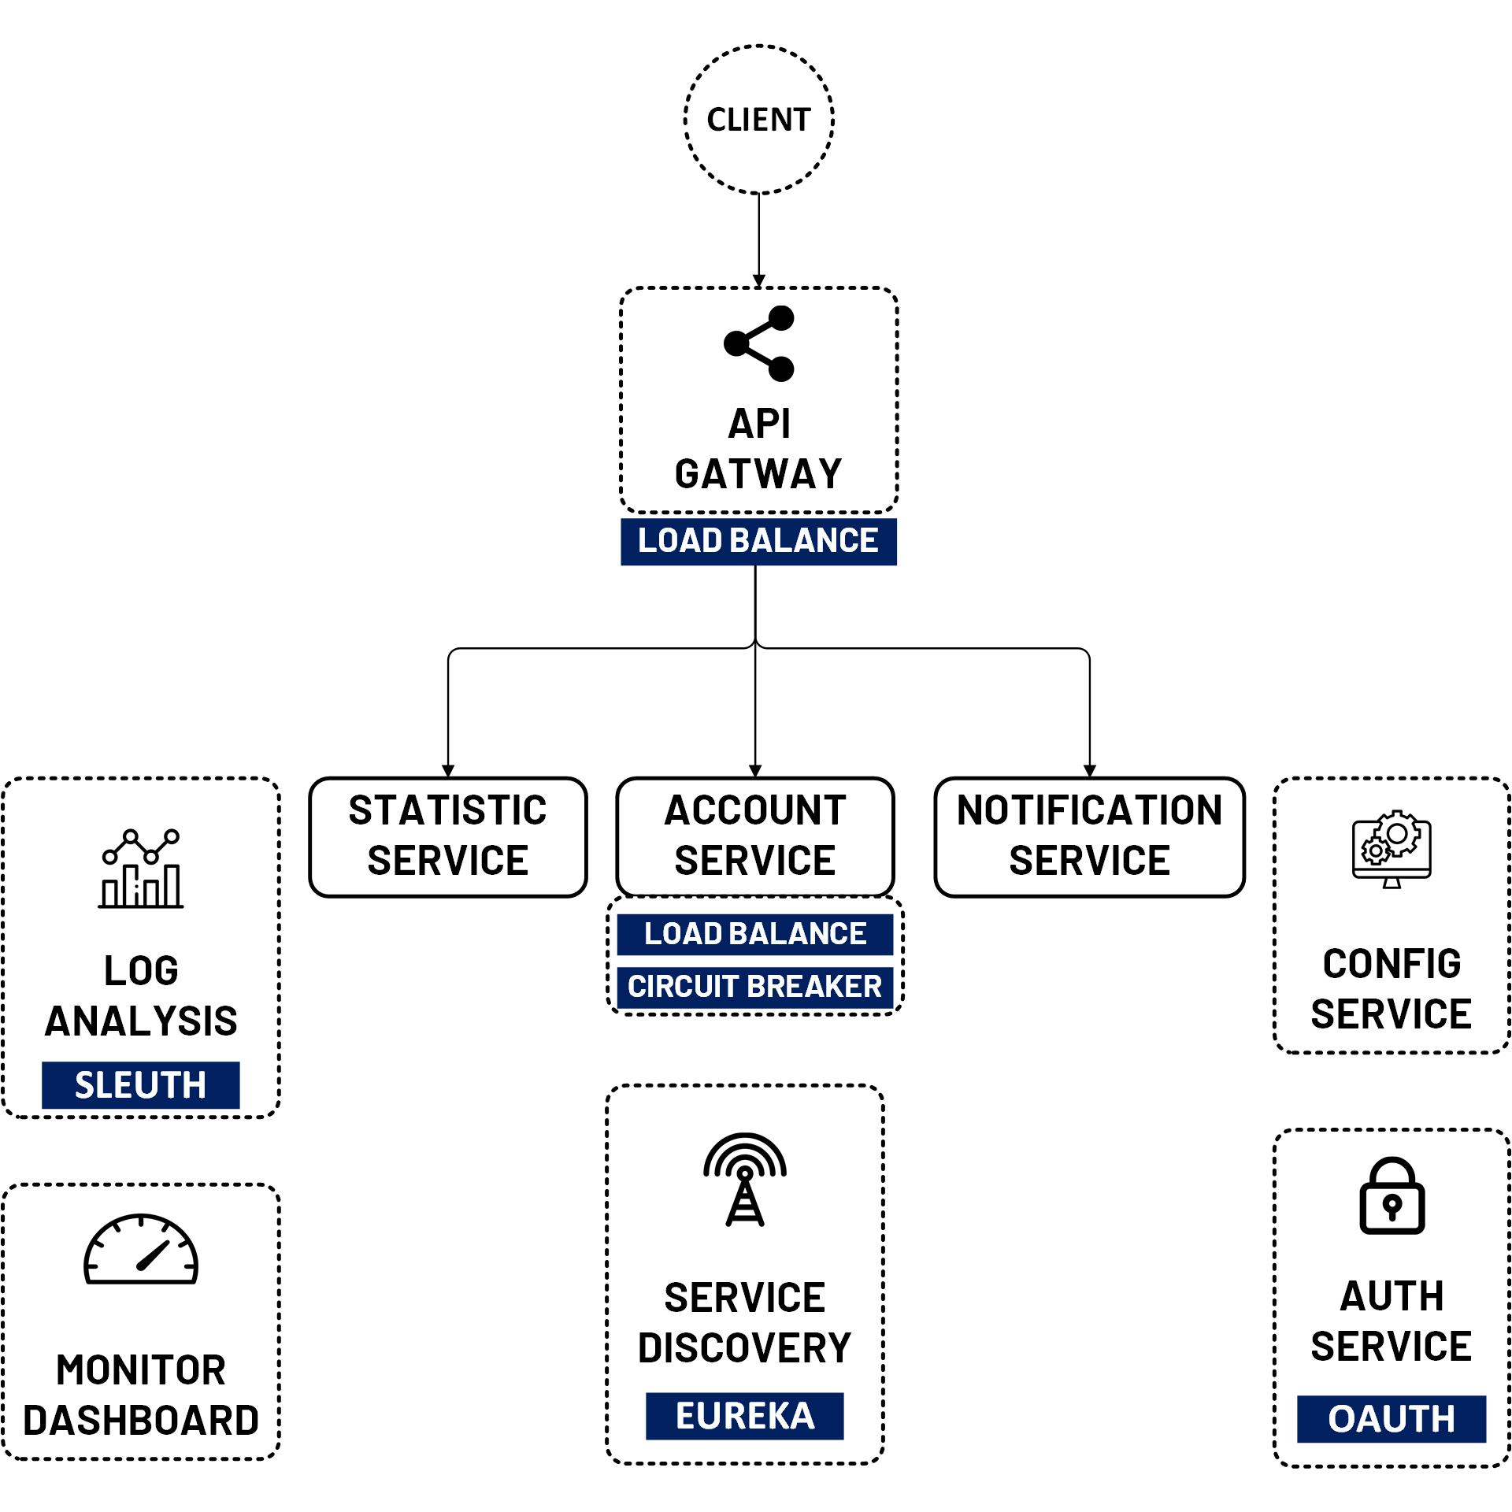

OAuth 2 Security Client Registration Server (JDBC)
www.jmaster.io/course/microservices-with-spring-cloud

